Slide 1
THE SMART EV WIRELESS CHARGING SYSTEM
Registration No. | Name
E021-01-0694/2019 | Eric Mulwa
E021-01-0716/2019 | Esther Mukite
E021-01-0693/2019 | Tom Ndolo
Supervisor: Dr. Agnes Wangai
D
Y
E
G
D
AN
O
IV T
L
K
IM
AT
HI
UN
ERSI
Y O
F T
EC
H
NO
Friday, 14th July 2023
Dedan Kimathi University of Technology

Slide 2
Background of the Study
Nikola Tesla’s Wardenclyffe Tower
WPT methods:
IPT
CPT
IPT Topologies: SS, SP, PS & PP
Smartphone Wireless Chargers (Qi 2010)
Evs Wireless Charging (SAEJ2954)

Slide 3
Problem Statement & Justification
Problem:
Electric vehicles Flux Linkage Power Losses, Need for automation, Wired-charging hazards and Need for convenience through technology.
Justification:
Completely automate every aspect of self-driving EVs, provide more convenience and maintain aesthetics by reducing visual clutter.

Slide 4
Objectives (Main and Specific)
Main:
To develop and implement a Smart Electric Vehicle Wireless Charging System Prototype
Specific:
To design the SevWCS Transmitter and Receiver.
To evaluate the performance of the different coil-separation distances (0.01m, 0.1m, 1m & 10m).
To simulate the SevWCS on Proteus 8 Professional.
To implement and test the functionality of the SevWCS prototype.

Slide 5
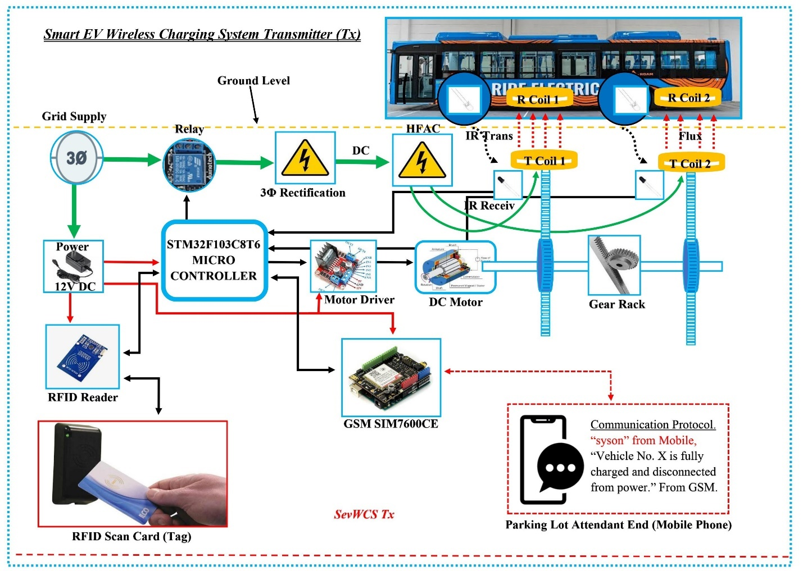
The Smart EV Wireless Charging System Block Diagram

Slide 6
Literature Review
Mohamed et al proposes a new wireless charging system for electric vehicles using two receiver coils [3].
Kishore N. and Amjad et al explores all the principles of wireless charging in electric vehicles [2] [1]

Slide 7
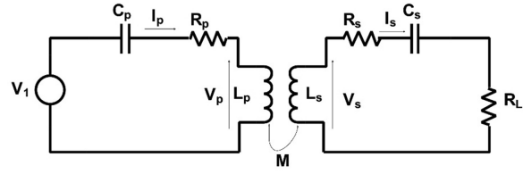
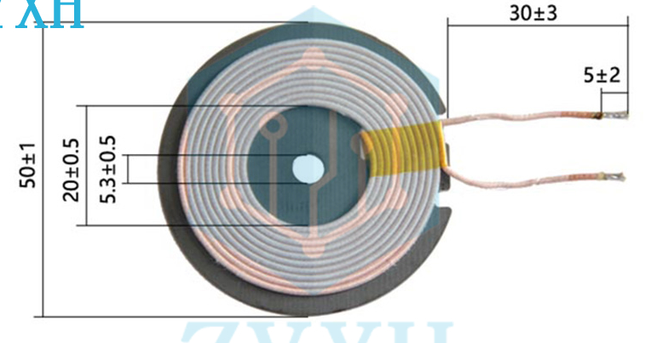
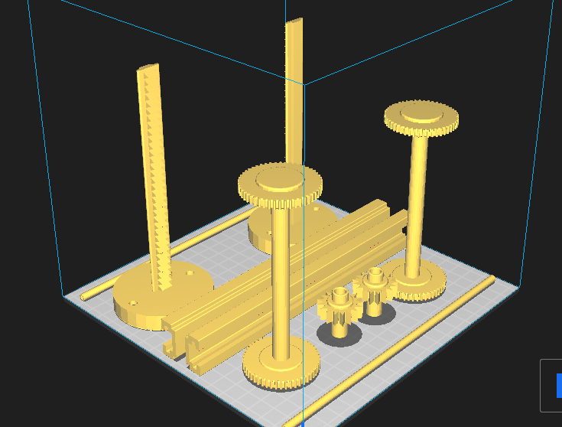
Methodology
SS Topology
Induction Coil
AutoCAD MEP Wooden Block Design
Ultimaker Cura 3D Prints

Slide 8
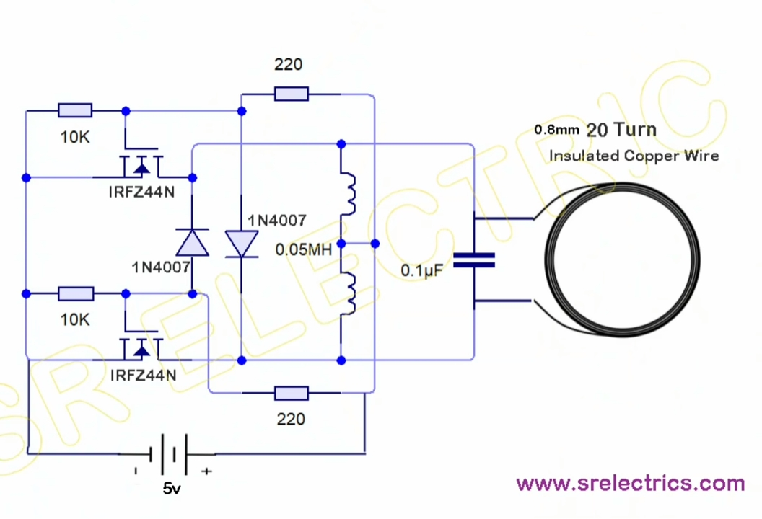
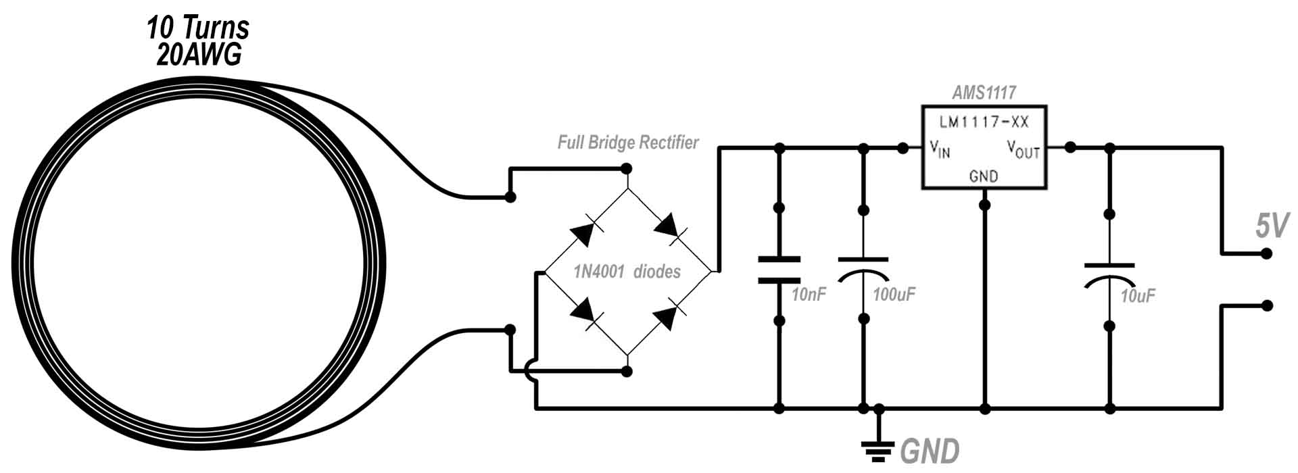
Transmitter & Receiver Prototype Circuits
Rectification Circuit (Rx)
Inverter Circuit (Tx)

Slide 9
SevWCS Simulation Block Diagram

Slide 10
Results and Discussions

Slide 11
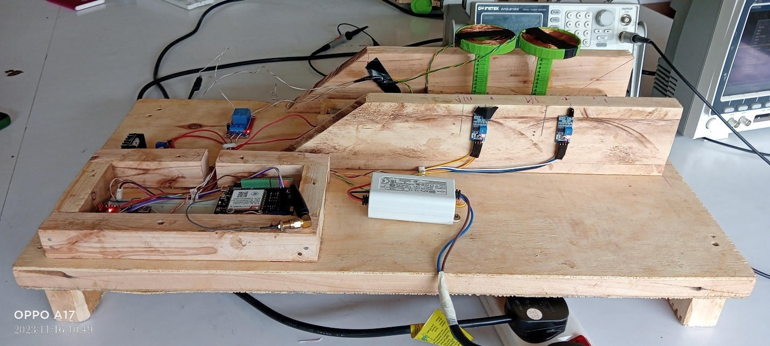
Results and Discussions

Slide 12
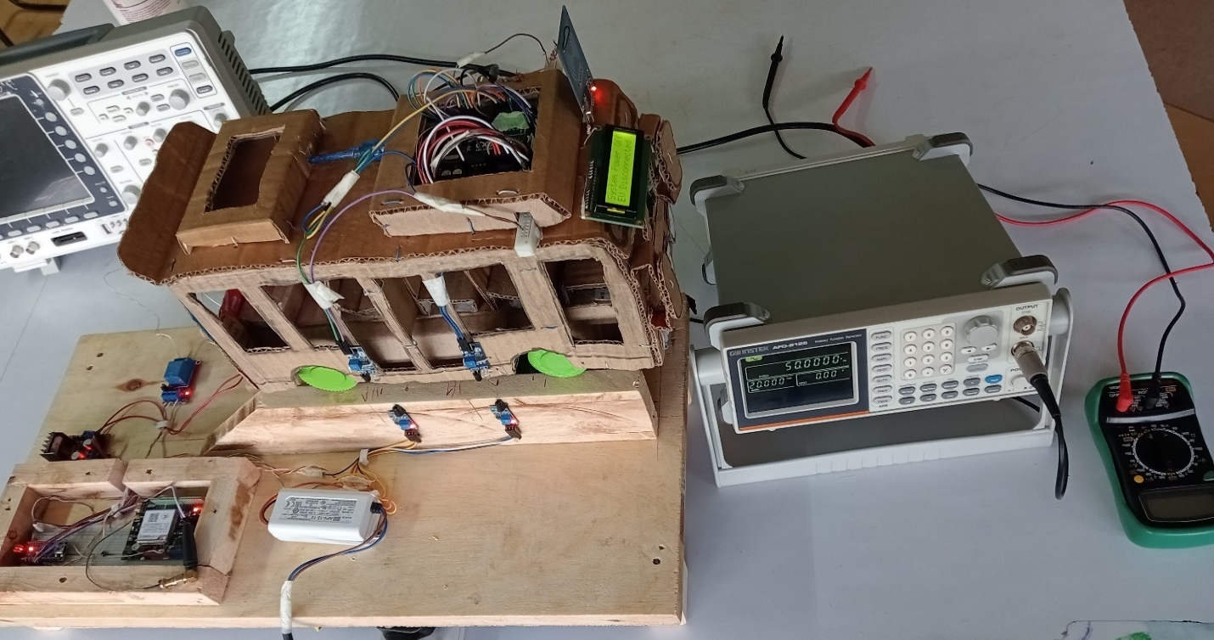
Results and Discussions

Slide 13
Conclusions
The proposed SevWCS Prototype was successfully realized with the main and the specific objectives achieved.
The efficiency of the prototype was 55% which can be improved with better transceiver coils and constant power supply

Slide 14
Recommendations
Implementing reinforcement learning and deep learning algorithms to reduce misalignment errors.
Employing quantum computing methods for better power transmission with more precision and speed.
More consideration and study must be given to enhancing shielding, in order to promote health and safety.

Slide 15
References
[1] Amjad, M., Farooq-i-Azam, M., Ni, Q., Dong, M., & Ansari, E. A. (2022). Wireless charging systems for electric vehicles. Renewable and Sustainable Energy Reviews, 167, 112730. https://www.sciencedirect.com/science/article/pii/S1364032122006190
[2] Bertoluzzo, M. Wireless Power Transfer for Electric Vehicle (Doctoral dissertation, University of Padova, Italy). https://core.ac.uk/download/pdf/145233488.pdf
[3] Mohamed, N., Aymen, F., Alqarni, M., Turky, R. A., Alamri, B., Ali, Z. M., & Aleem, S. H. A. (2022). A new wireless charging system for electric vehicles using two receiver coils. Ain Shams Engineering Journal, 13(2), 101569. https://www.sciencedirect.com/science/article/pii/S2090447921003208

Slide 16



THANK YOU
Private Bag- Dedan kimathi, Nyeri-Mweiga road
Telephone: +254-061 2050000 Email: vc@dkut.ac.ke Website: www.dkut.ac.ke
D
Y
E
G
D
AN
O
IV T
L
K
IM
AT
HI
UN
ERSI
Y O
F T
EC
H
NO
Dedan Kimathi University of Technology

